Slide 1
State ownership, the institutional environment, and auditor choice: Evidence from China
Authors：Qian Wang, T.J. Wong, Lijun Xia
Presenter: Shuning Bao
Professor: Philip Dybvig
9/19/2019

Slide 2
Agenda
Introduction
Hypothesis development
Data and sample selection
Results
Conclusions
Opinions

Slide 3
1. Introduction
This paper studies how institutional features such as the extent of state ownership, the level of market and legal institutions’ development, and the degree of government power over auditors affect Chinese listed firms’ auditor choice decisions.
Local SOEs: Chinese state-owned enterprises controlled by province, city, or county governments
Central SOEs: SOEs controlled by central government
In 2003, 54% of Chinese listed firms hired auditors that are small (non-Top-10) and from the same locality (hereafter, small local auditors), whereas only 25% of Chinese listed firms hired Top-10 audit firms.

Slide 4
2. Hypothesis development
Before describing the hypotheses, the authors discuss how three institutional features of the Chinese political economy affect Chinese listed firms’ auditor choice:
the extent of state ownership,
the level of market and legal institutions’ development,
(3) the degree of government power over auditors

Slide 5
2.1 Demand argument
2.1.1 Local and central SOEs’ preferential access to capital
Stock market regulators give preferential treatment by extending listing privileges to local and central SOEs.
state banks give preferential treatment to local and central SOEs on loans granting
The government’s or state banks’ preferential treatment to local and central SOEs is likely to result in these SOEs’ lower demand for reputable (presumably large or non-local) auditors to serve as a signal of their quality.

Slide 6
2.1 Demand argument
2.1.2 Government bailout
Local and central SOEs receive government backing that provides financial insurance to outside shareholders. In contrast, without the protection afforded by the government, non-state firms are under more pressure to hire reputable (large or non-local) auditors to mitigate the agency problem and provide an early warning of any possible financial distress.

Slide 7
2.2 Local knowledge argument
Many auditors in China were closely affiliated with their local governments until they separated themselves from the government in 1998. After the separation, however, most accountants remained in their audit firms, carrying with them specialized knowledge of the local SOEs or central SOEs that are in the same regions.

Slide 8
2.3 Collusion argument
Chinese listed firms have incentives to hire acquiescent auditors, who would allow their clients to manipulate earnings by not issuing a modified opinion that may lead to a share price decline and trigger government sanctions such as delisting.
Although non-state firms, local and central SOEs all have incentives to collude with auditors, government owners of local SOEs face the least collusion costs because of their political power over local auditors, especially small local auditors.

Slide 9
2.4 Hypotheses
Hypothesis 1: Local and central SOEs are more likely than non-state firms to hire small local auditors.
Hypothesis 2: The difference in the propensity to choose small local auditors between non-state firms and local or central SOEs is larger in regions with more local government involvement in business and with less developed market and legal institutions.

Slide 10
Measure the quality of regional institutions
The credit market development index
The government decentralization index
The legal environment index
(These three institutional indexes are obtained from the National Economic Research Institute (NERI) Index of Marketization of China’s provinces in 2000 to measure the quality of market-supporting institutions at the provincial level.)

Slide 11
3. Data and sample selection
Begin by collecting auditor choice data of all listed companies in China from 1993 to 2003
Classify the sample audit firms as small vs. Top-10 based on total assets audited
Identify local vs. non-local auditors
Finally, separate the sample into three ownership categories: (1) non-state firms, (2) local SOEs, (3) central SOEs

Slide 12
Table 1 Sample selection process

Slide 13
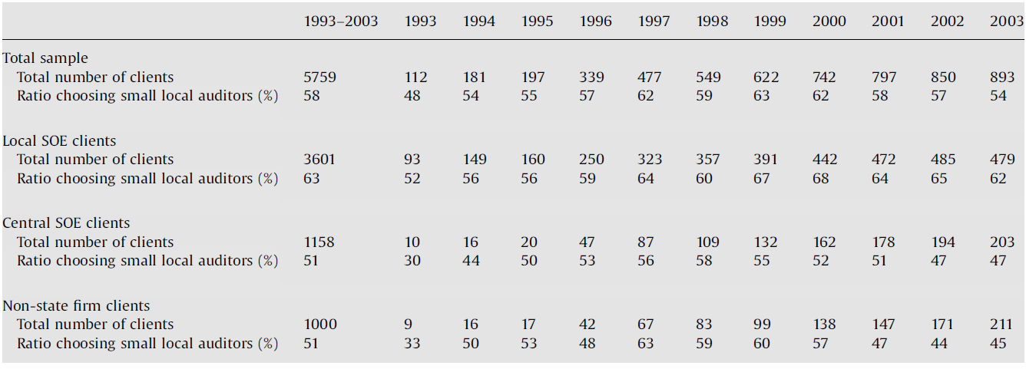
Table 2 Sample by ownership type and auditor type

Slide 14
4. Results – Hypothesis 1
This paper tests Hypothesis 1 by regressing a dummy variable indicating whether the auditor is a small local auditor on the following three sets of variables: (1) two ownership-type variables, Local SOEs and Central SOEs; (2) three index variables; and (3) firm characteristic and financial control variables
The regression results show that local SOEs are more likely than non-state firms to choose small local auditors

Slide 15
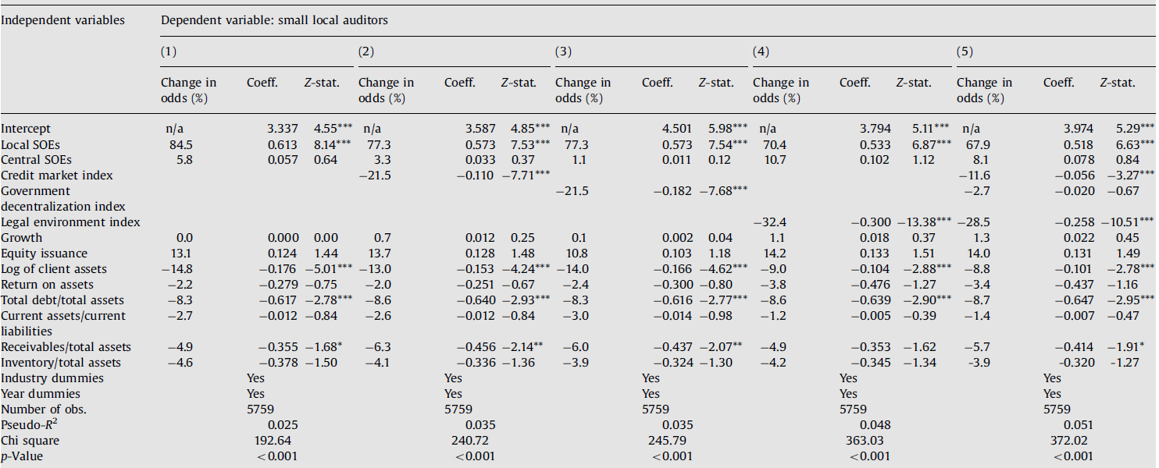
Table 3 logistic regressions – hypothesis 1

Slide 16
4. Results – Hypothesis 2
Next this paper tests Hypothesis 2, i.e., whether the effect of government ownership on auditor choice varies with the quality of institutions.
Add the interaction terms between government ownership (Local SOEs and Central SOEs) and the three institutional indexes to the regression model. Hypothesis 2 predicts that when market and legal institutions are more developed or when the government intervenes less, local and central SOEs are more likely to behave the same as non-state firms in choosing auditors.

Slide 17
Table 4 logistic regressions – hypothesis 2
When institutions develop, the positive effect of local government ownership on the choice of small local auditors decreases.
Although central SOEs as a whole do not exhibit a significantly stronger tendency than non-state firms to hire small local auditors, they are more likely to hire small local auditors in regions with less developed institutions.

Slide 18
5. Conclusions
This paper analyzes how political and economic institutions affect the choice of auditors in China. Using a sample of firms covering the period from 1993 to 2003, the authors find that local SOEs are more likely than non-state firms to hire small local auditors. In addition to local SOEs, central SOEs are also more likely than non-state firms to hire small local auditors in regions where institutions are less developed, but this tendency of local and central SOEs to hire small local auditors is significantly attenuated in regions with more developed institutions.
Additional analyses show that local and central SOEs’ tendency to hire small local auditors is consistent with the three arguments (Demand argument, Local knowledge argument, Collusion argument).

Slide 19
6. Opinions
Client firms’ ownership types and auditor choice are likely to be endogenously determined by institutional factors. In that case, we cannot infer causality in the relation between client firm’s ownership types and auditor choice from the results ——instrumental variable
Comprehensive and instructive

Slide 20
Thank you！

